Slide 1

哔哩哔哩_咻管家

Slide 2



MIEC_EE308 Software Engineering _ Course Project _ Develop applets based on open source software
Bilibili_xiu assistant
哔哩哔哩_咻管家
XIU, get the latest updates anytime，anywhere
咻一下，随时随地得到最新推送

Slide 3
Requirements Document
Langcent互联网股份有限公司
09/11/2021

Slide 4
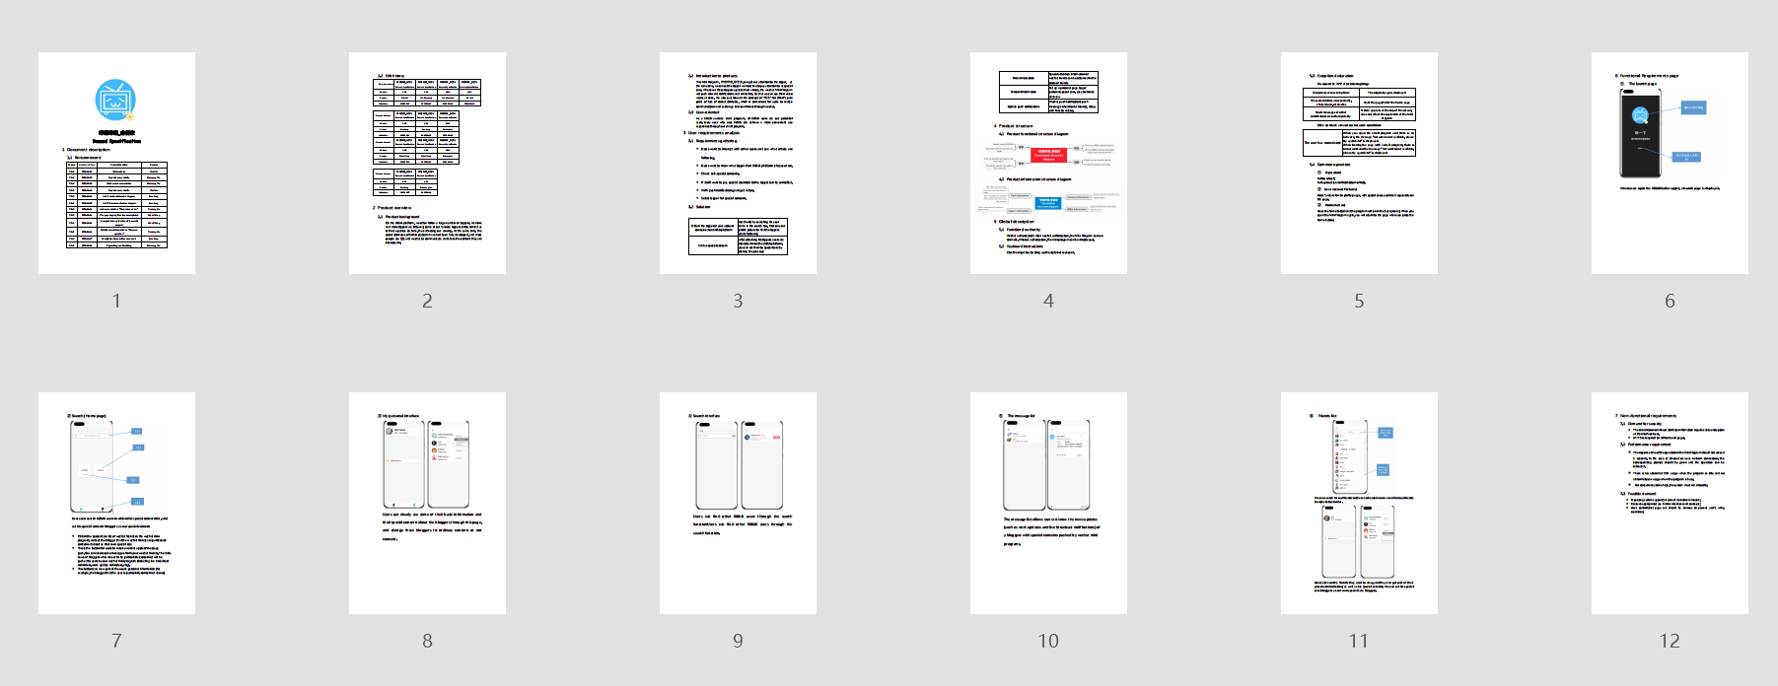
The result of a week's work by all the team members
A Product Requirements Document

Slide 5
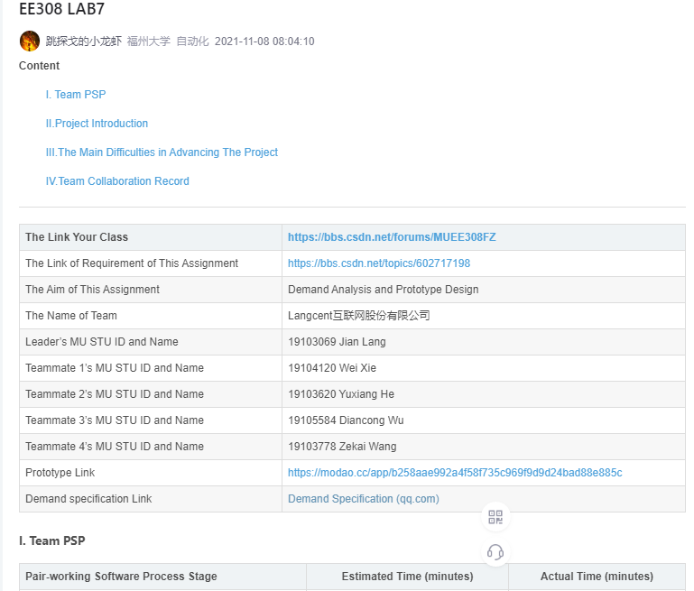
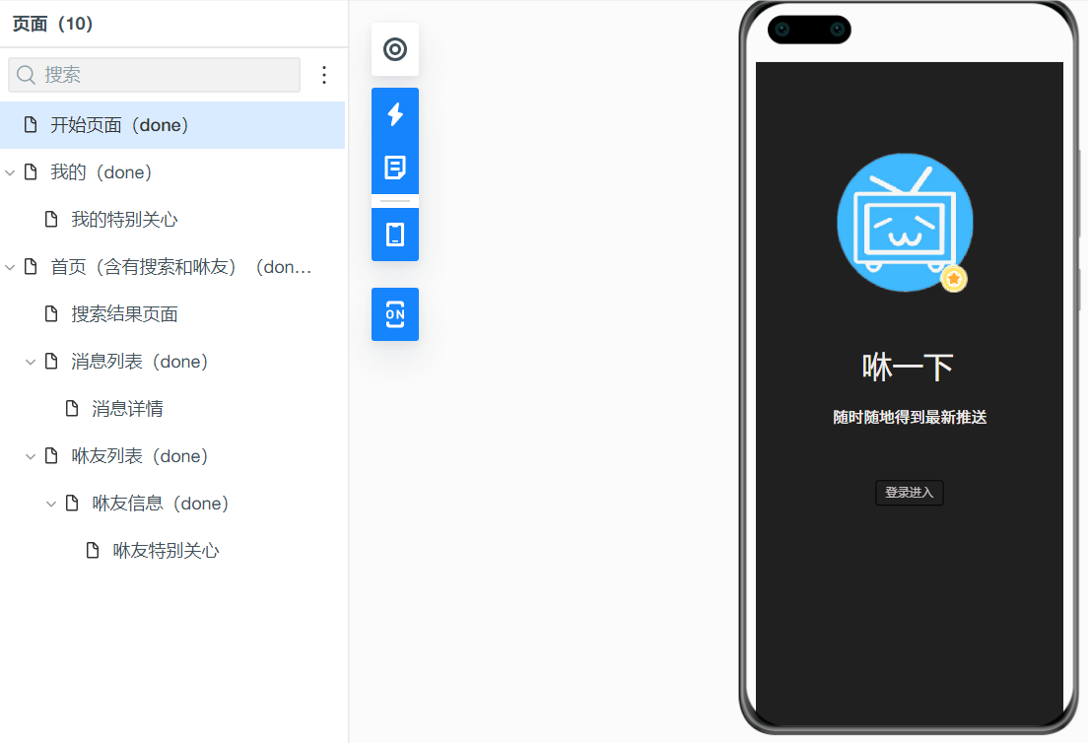
A blog & A prototype

Slide 6
What we did
——Reasonable plan and clear division of labor
Requirements documents that meet specification requirements
A blog that showcases our team's efforts and achievements
Simple, beautiful and realistic UI prototype design draft
Independent learning, information retrieval, learning and application
Team work together, make concerted efforts!

Slide 7
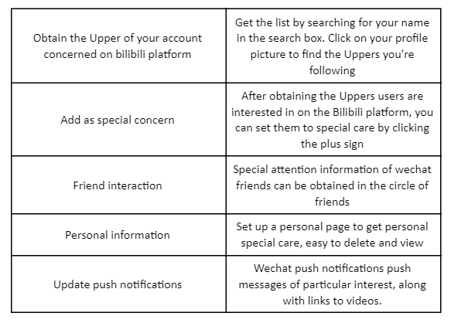
The design is consistent with the requirements document!
Do what we want to do, every pain point is what we want to solve.
We are already doing it, we are making it happen!

Slide 8
PRD Achievement Presentation

Slide 9
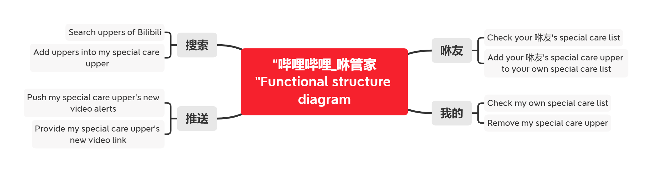
Results show
Product functional structure diagram

Slide 10
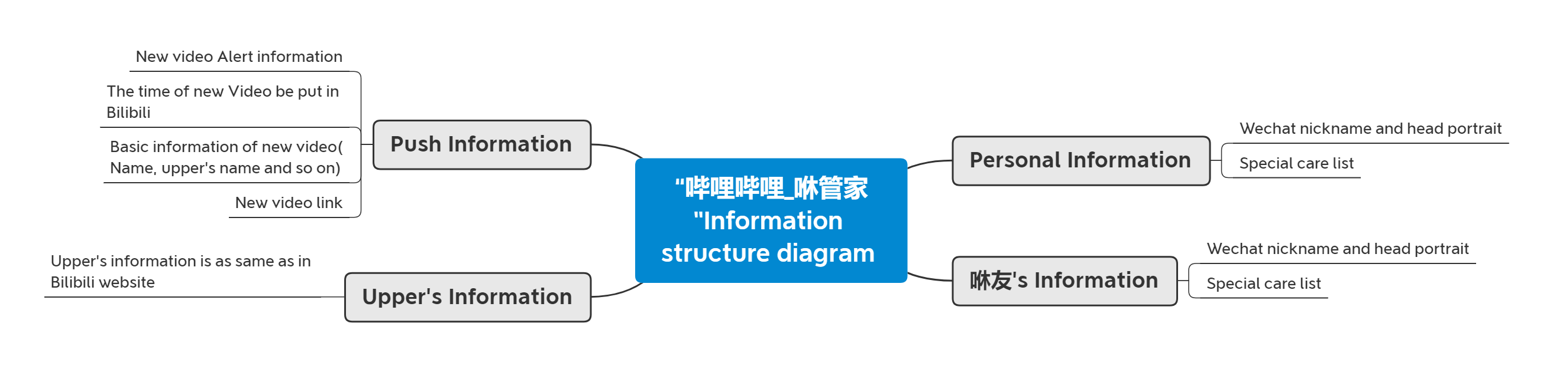
Results show
Product information structure diagram

Slide 11
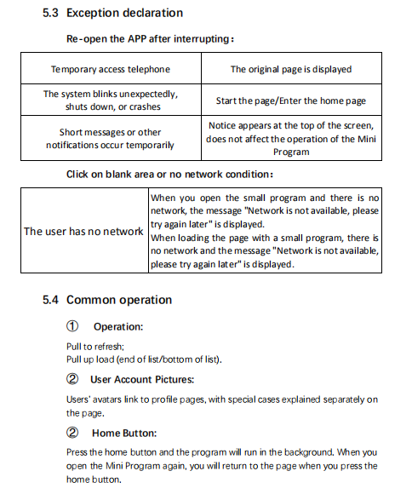
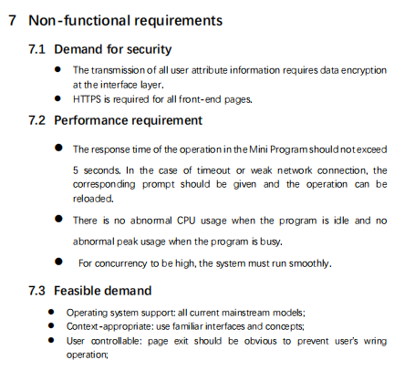
Results show
Complete documentation, including User Requirements Analysis, Exception Declaration, Common Operation, non-functional requirements, and more。

Slide 12
“Full documentation, full instructions”
-- every programmer can understand it and implement it

Slide 13
Display of Acceptance Criteria

Slide 14
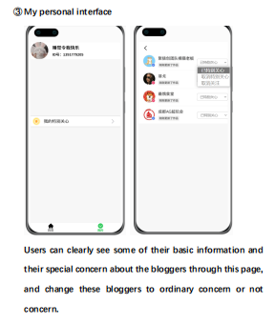
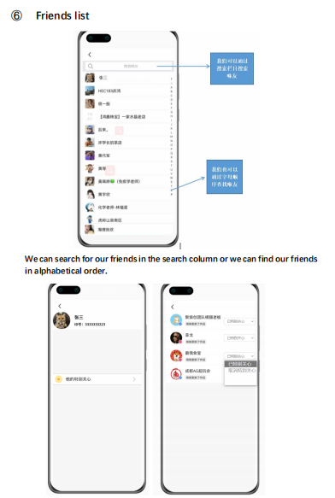
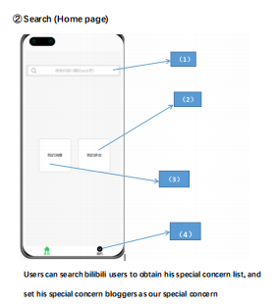
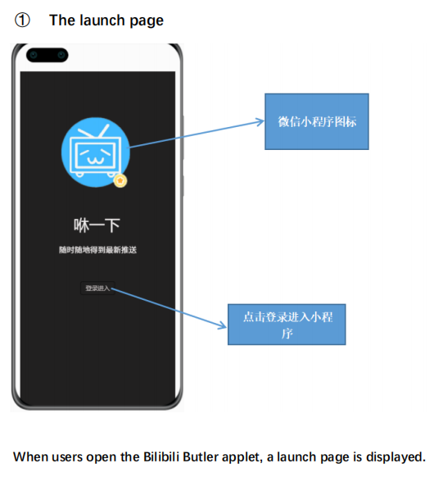
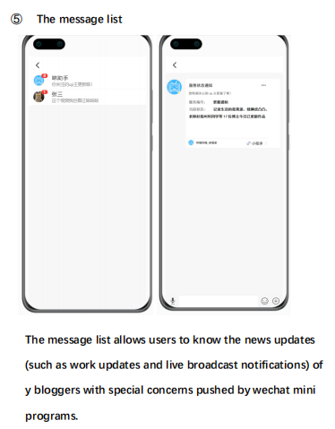
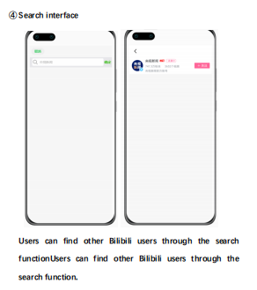
Complete design prototypes. What we do is what we get.

Slide 15
WE ARE A TEAM!
“用我们的心，做同一件事”

Slide 16
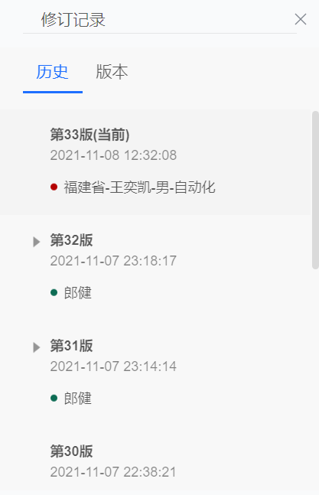
Team collaboration
We wrote it together
- up to 30 times

Slide 17
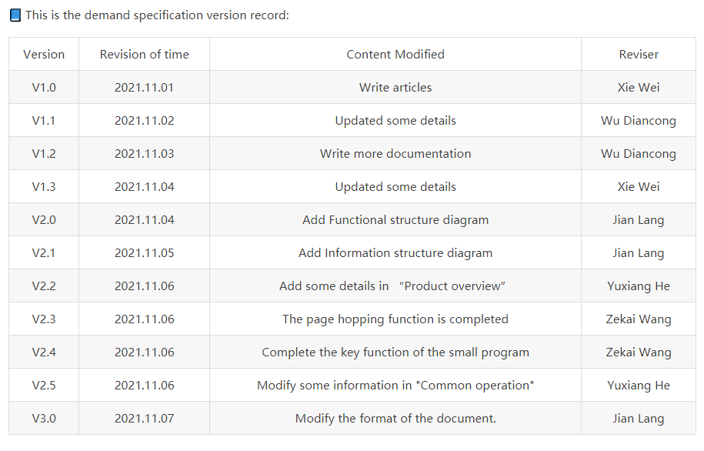
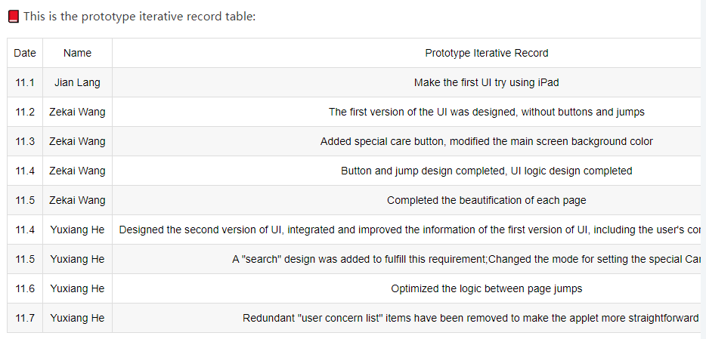
Team collaboration
Demand specification version record
& Prototype iterative record

Slide 18
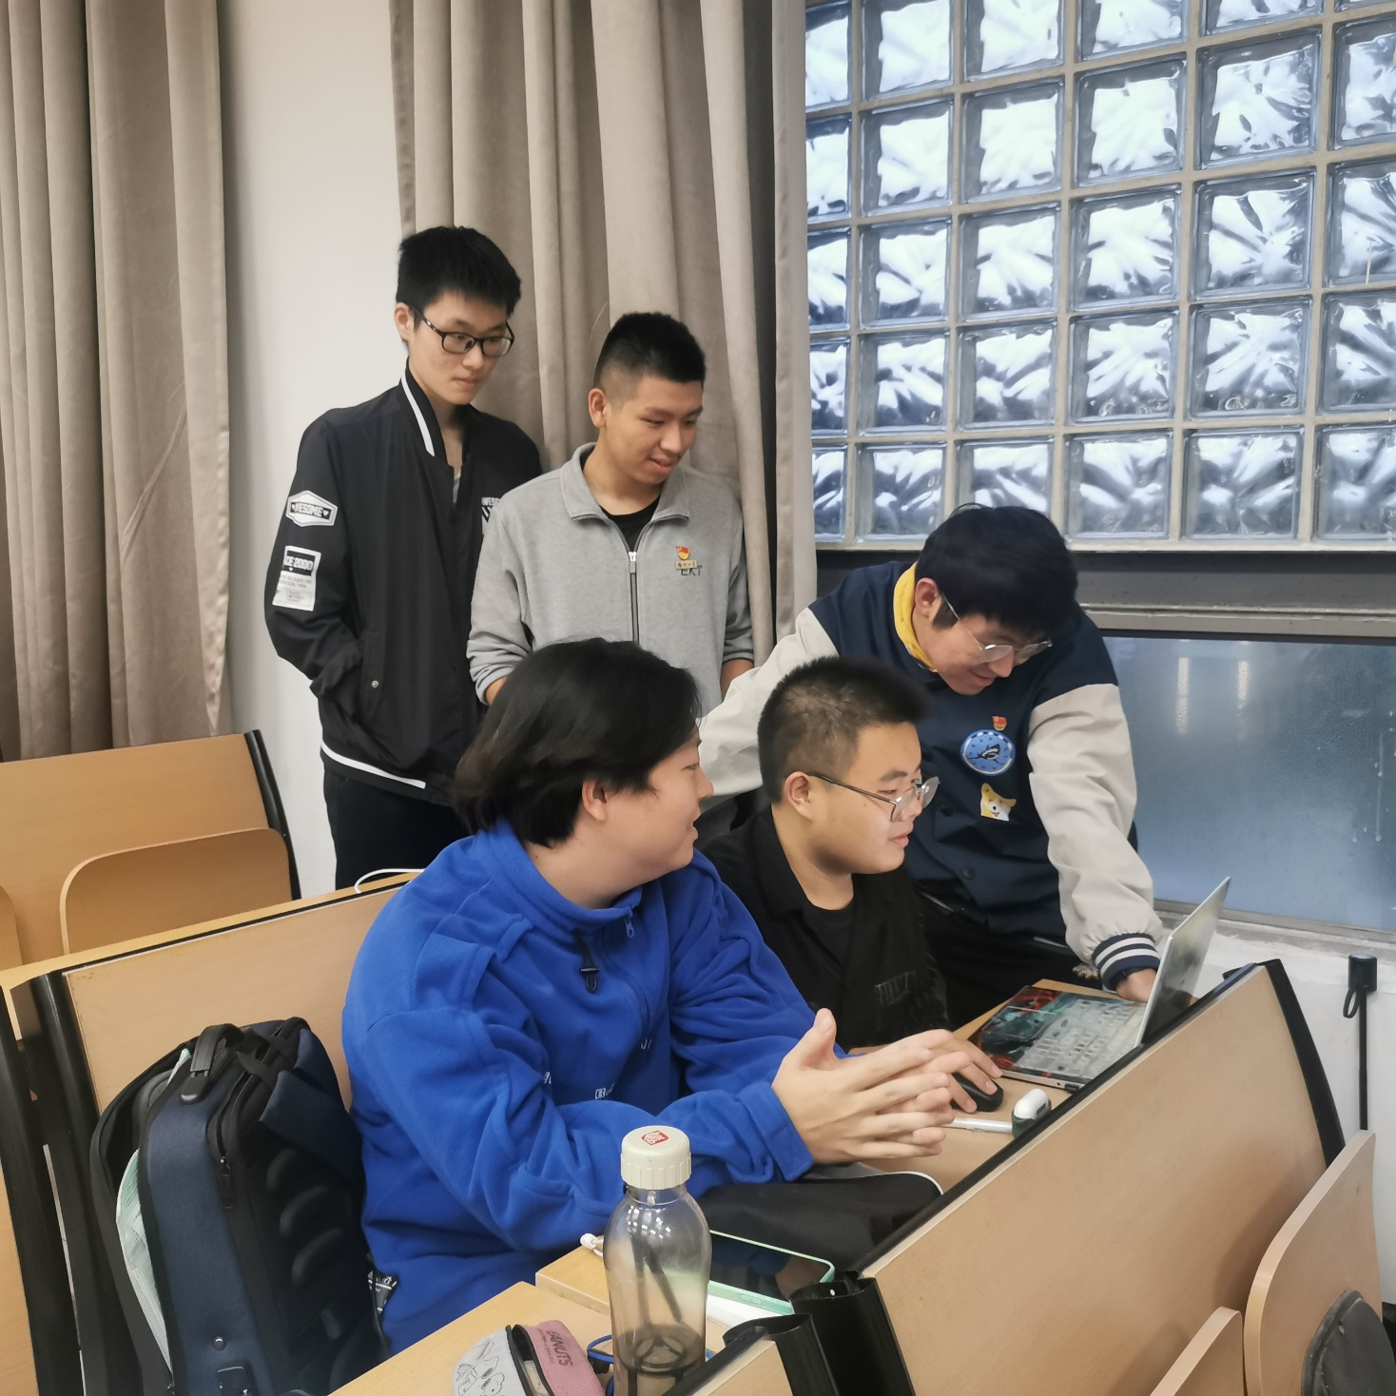
Team collaboration
Here comes the family photo！

Slide 19
EXPECT THE STORY TO HAPPEN

Slide 20
MIEC_EE308 Software Engineering _ Course Project _ Develop applets based on open source software
Bilibili_xiu assistant
哔哩哔哩_咻管家
XIU, get the latest updates anytime，anywhere
咻一下，随时随地得到最新推送

